Slide 1
Getting started with RStudio
Meredith Broadway
Business and Data Analysis Librarian. Owen Graduate School of Management

Slide 2
A quick introduction…
R is a programming language that has developed (primarily) for and by benchmark science. Most of the R users you meet work in STEM.
Check out the #rstats hashtag on Twitter
R is not a “broken” programming language. R is a very powerful tool for manipulating, analyzing, and visualizing data. R contends with Python as a language and tool worth learning.
R has a thriving and growing community. See more in the “Help! I need somebody!” slide.
Hadley Wickham is Chief Scientist at RStudio. He created a collection of R packages called the “tidyverse.” You will see Wickham and the tidyverse mentioned everywhere in R-land. He will be your patron saint as you learn R/RStudio.

Slide 3
Download R & RStudio
RStudio is an integrated development environment (IDE) of R. You cannot download RStudio without standard R.
Download the most recent version of R here (version 3.4.3: Kite-Eating Tree).
Download the most recent version of RStudio here. Make sure to choose the right installer for your platform (i.e., Windows or Mac).

Slide 4
Exploring RStudio: Let’s start at the very beginning
Open RStudio
Open an R script. A script is where you will execute all your R calls and commands (see slide 5 for .gif).
File > New File > R Script
Try saving your R script
File > Save as
Your script will be saved as an .R object
Easy, right? Let’s keep going!

Slide 5
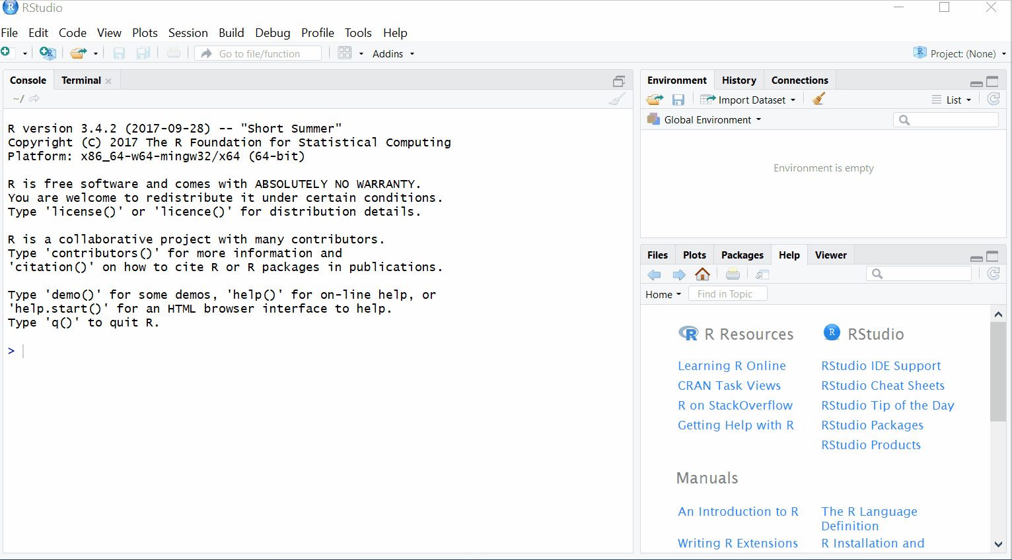

Slide 6
Exploring RStudio: Upload a dataset
You can upload data in a variety of formats (.csv, .txt, .json, etc.) in one of two ways in RStudio.
First option to upload data: Import Dataset (see slide 7 for .gif).
Second option to upload data: read function. Functions you will typically use: read.csv(), read.delim(), read_json() (see slide 8 for .gif).
Your dataset will automatically be uploaded into an R object called a data frame. This is the easiest object to work with in R. Think of a data frame as a fancy Excel sheet.

Slide 7
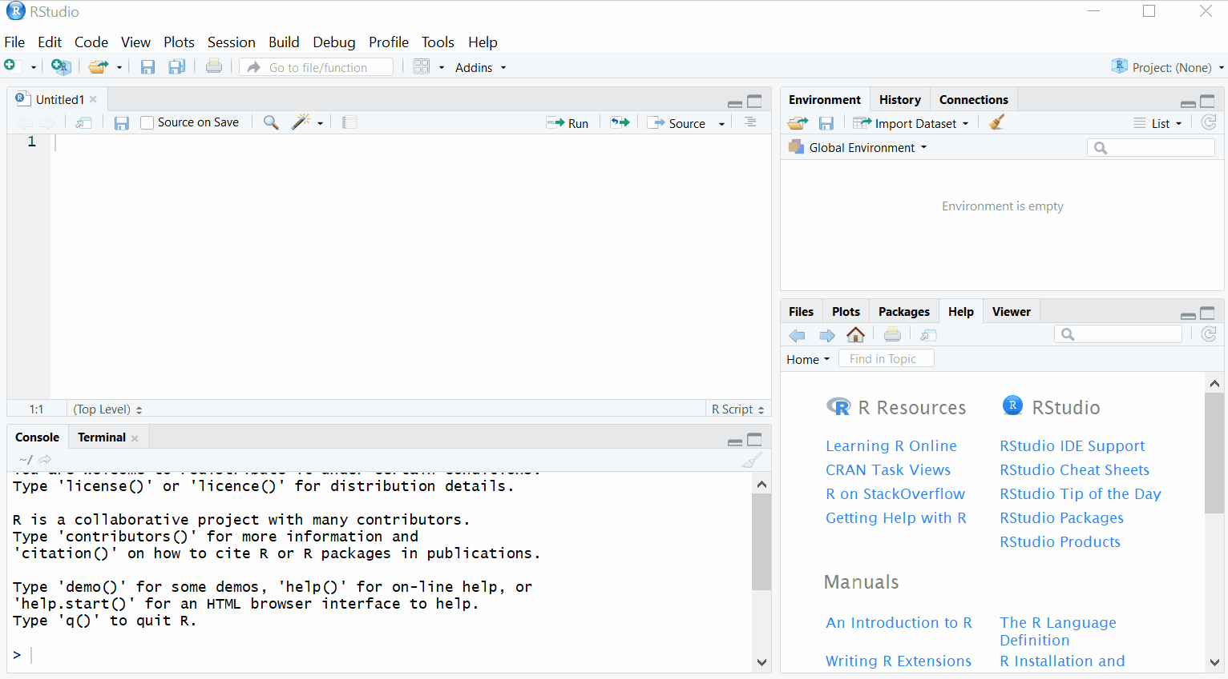

Slide 8
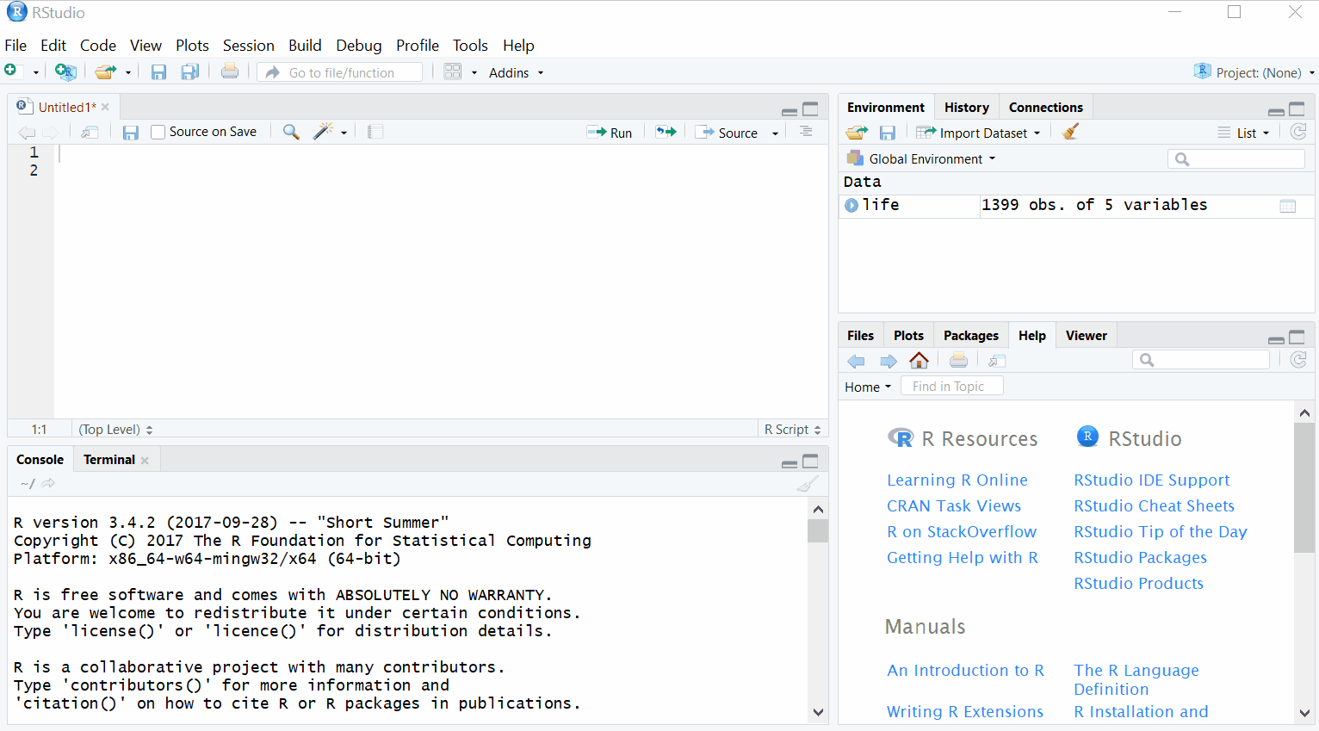

Slide 9
Exploring RStudio: Plotting 101
When you first use R/RStudio, you’re going to learn using “base R.” Base R is the most basic form of R you can use. (See slide 10 for .gif of using base R to plot a histogram.)
As you learn to use libraries* in R, you’ll upgrade to a more complex form of R. The language is still the same, it just becomes more mature.
*I will explain the concept of libraries in greater detail in my workshop. For now, think of libraries as a literal library with stacks and books.
Ex: If you want to write a paper on policy concern in the Tennessee Supreme Court, you go to the law library and pick up books on TN’s historic rulings. Likewise, if you want to visualize data in R, you’re going to want to use the ggplot2 or plotly libraries.
Basically, what you want to accomplish in R will determine what libraries you use.

Slide 10
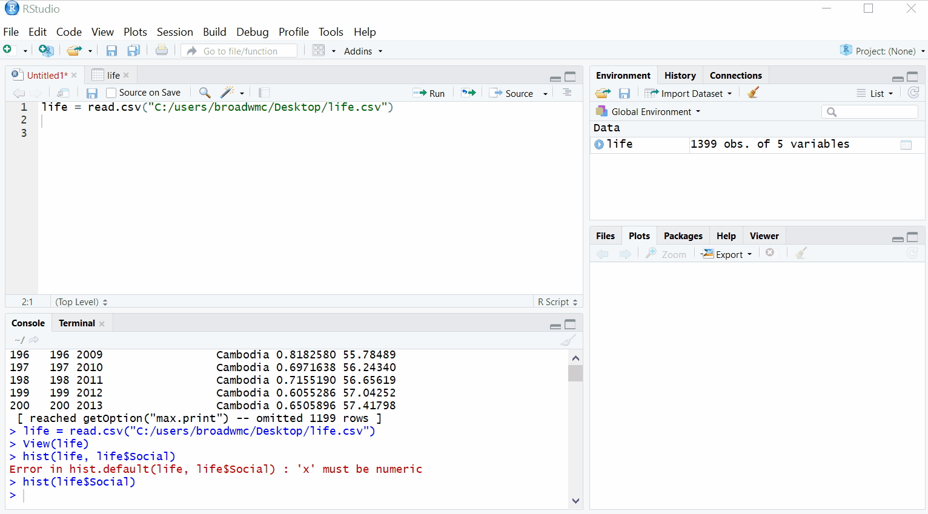

Slide 11
Exploring RStudio: Help! I need somebody!
If you ever need help navigating RStudio you can simple execute: ? + the object you have a question about. (See slide 12 for .gif)
You can also use Help as an ordinary search engine. Simply type the object you have a question about in the ‘Find in Topic’ bar.
Beyond RStudio:
R/RStudio has an outstanding community on Twitter. Worth a follow: Hadley Wickham, Jenny Bryan, Mara Averick.
stackoverflow.com
r-bloggers.com

Slide 12
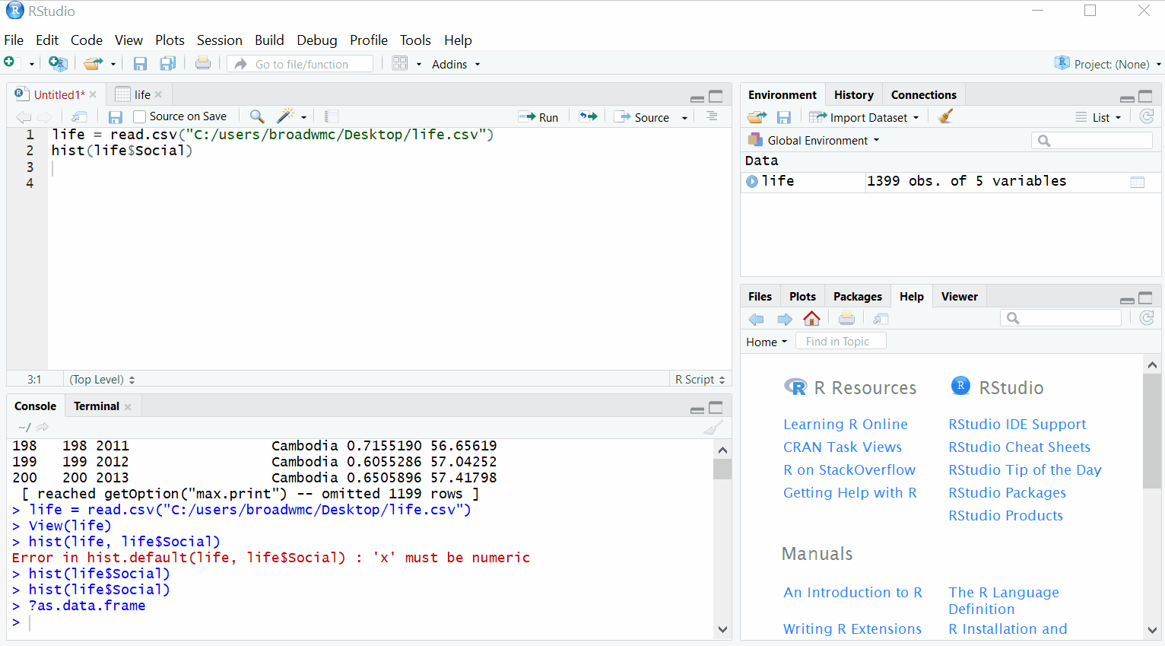

Slide 13
Learning to fly_Tom Petty.mp3
Keep on exploring RStudio! The user interface is intuitive.
It will be good to have a basic knowledge of how to knock around RStudio for the workshop.
Libraries I will use: ggplot2, magrittr, shiny
I will cover reactive expressions and if/else statements
I will also explain two different kinds of statistical models: linear and LOESS
If you’re feeling fancy, download my RShiny app on Github. Take note of helpful instructions in the README. Try and run the app in RStudio.

